Slide 1
Beyond MOOCs - Educating Everybody
Dr. Charles R. Severance
University of Michigan School of Information
www.dr-chuck.com

Slide 2
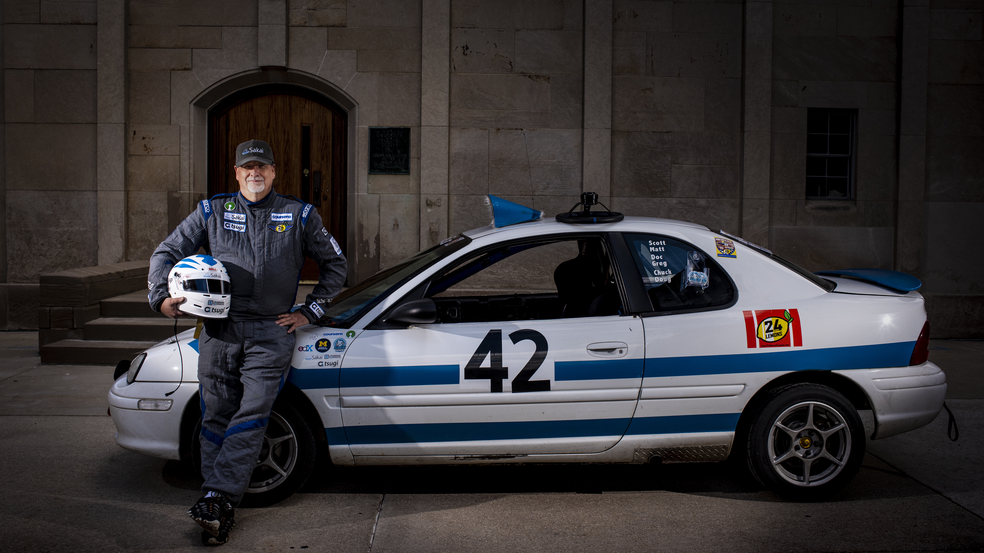
2.8M
19
825K
MOOCs
students enrolled to date
course
completers
21K
completions
last
week
Python for Everybody Django for Everybody

Slide 3
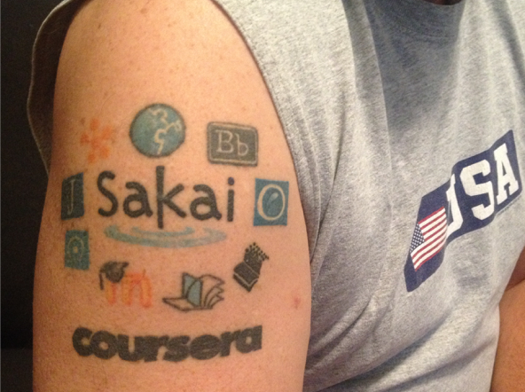
IMS Learning Tools Interoperability Ring of Compliance

Slide 4



Slide 5
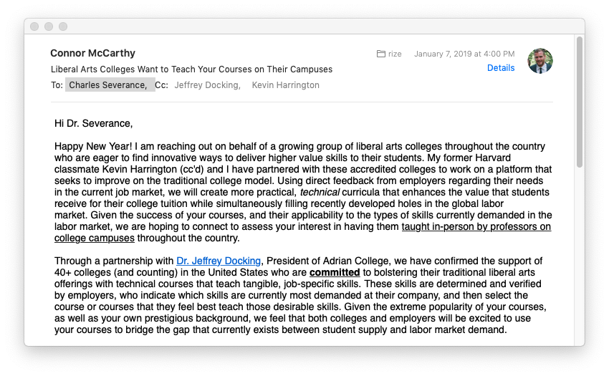

Slide 6
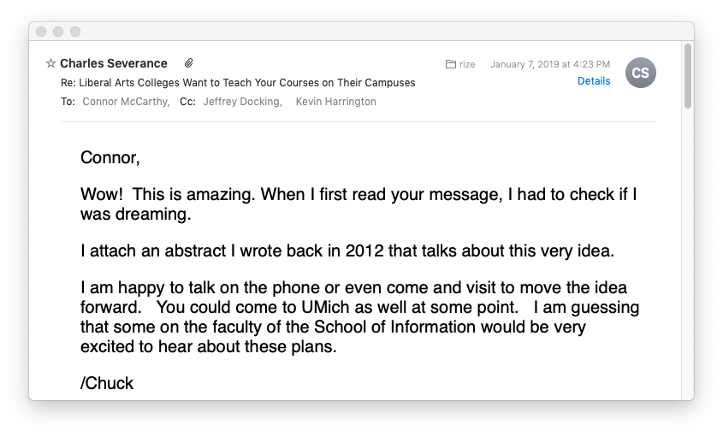

Slide 7
The Liberal Arts are a set of subjects that we deem as essential for all free citizens to study. The concept dates back to over 2000 years ago. But over time the list of subjects evolves based on the changing nature of the world. Have we reached the point that Technology needs to become one of the core Liberal Arts? ... For any subject to be a Liberal Arts - it must be taught in a manner to engage, enlighten, and fuel the curiosity of the the student.
Charles R. Severance - 2012

Slide 8
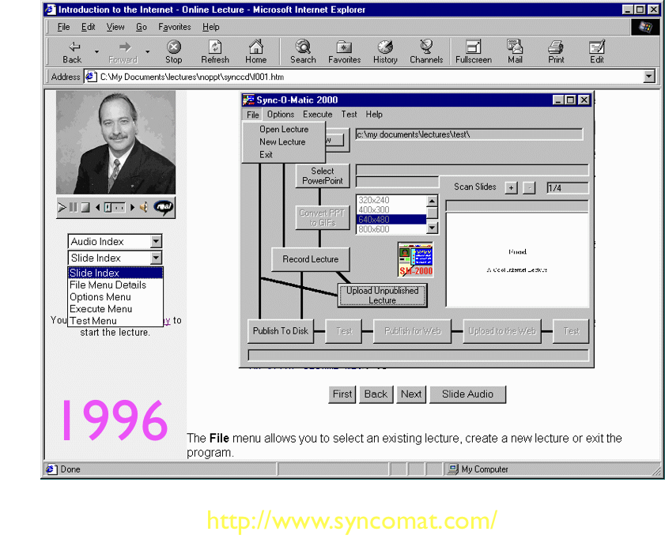

Slide 9
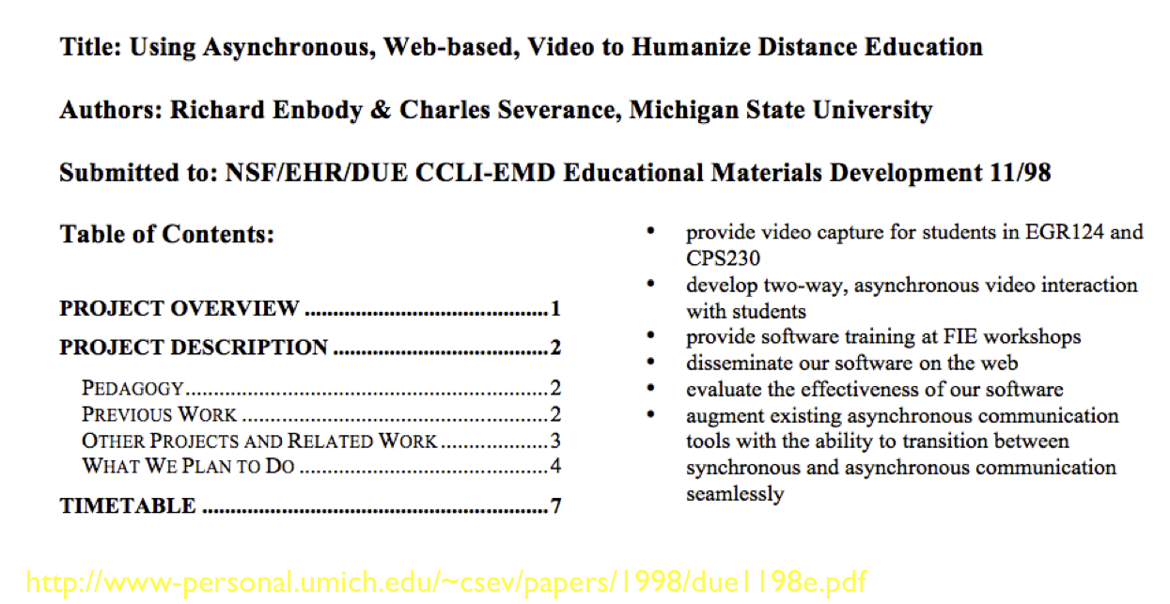

Slide 10
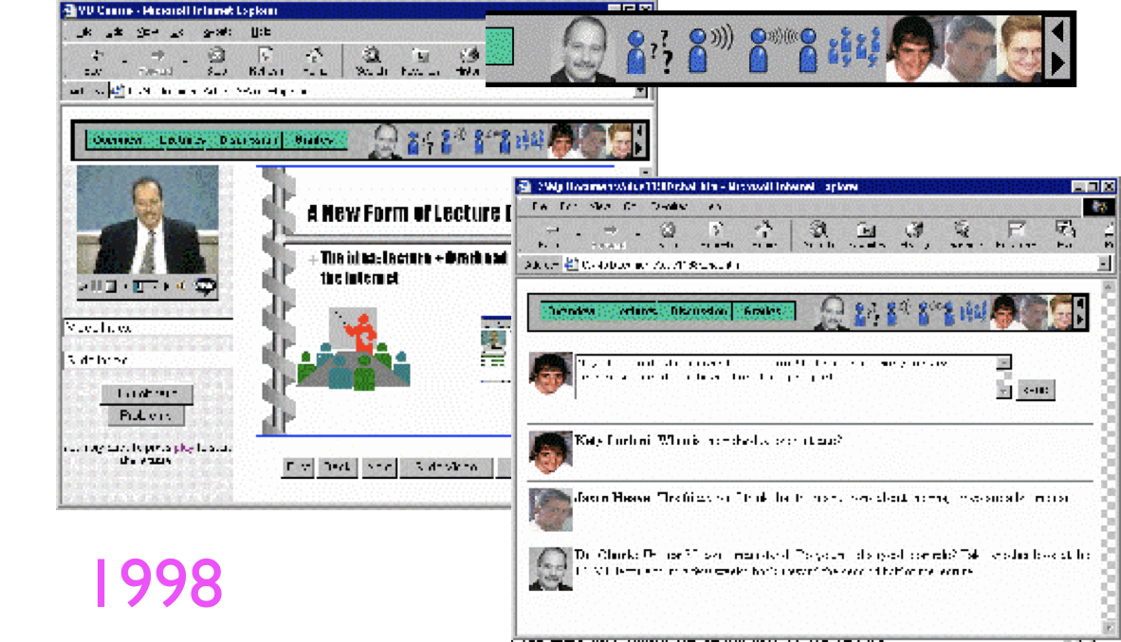

Slide 11
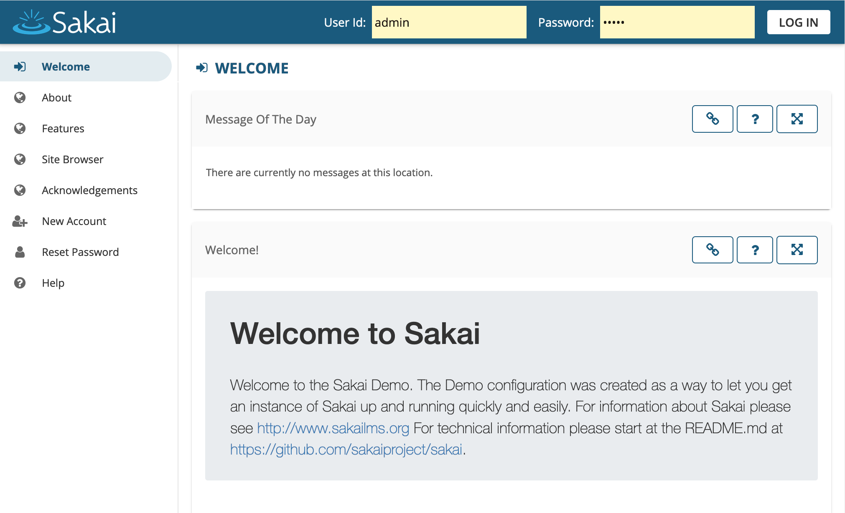
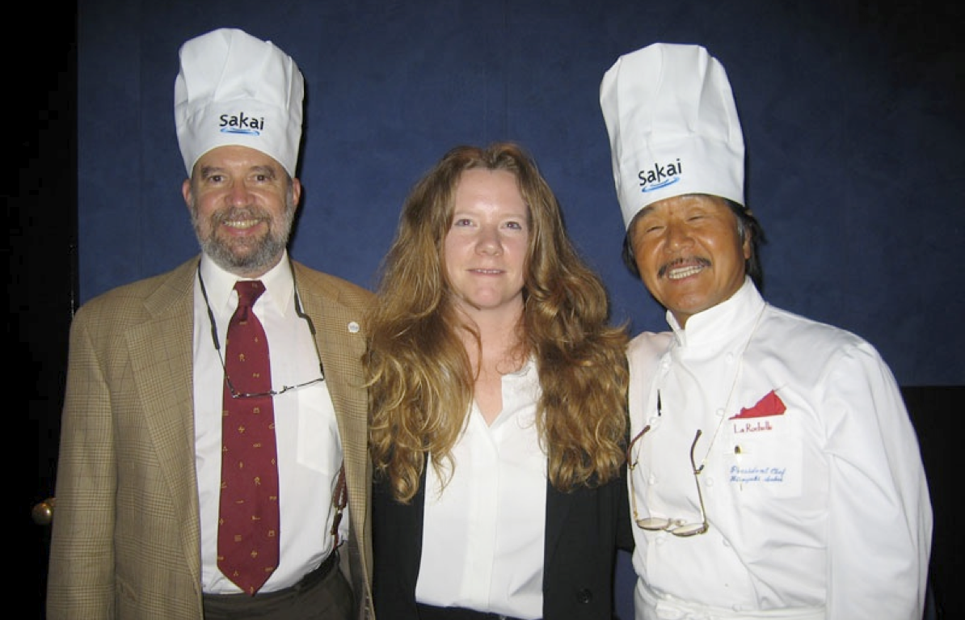
2004

Slide 12

Trouble IN PARADISE
2007

Slide 13
IMS Learning Tools Interoperability Ring of Compliance
2010

Slide 14
“Expensive and lazy professors will be replaced by professional actors.”
Doom-and-gloom MOOC reactions “experts” put forth in 2012
“Universities will have no students in 20 years and will have to sell their land to survive.”
2012

Slide 15
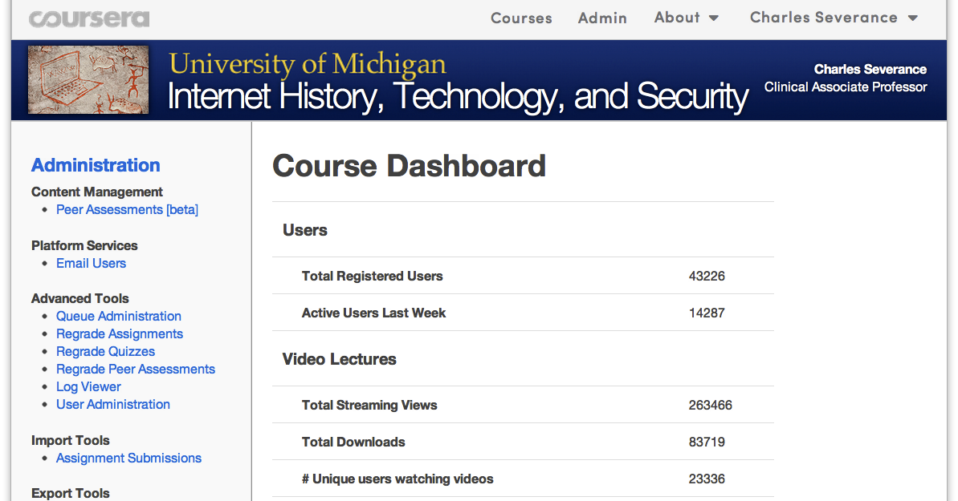
2012

Slide 16
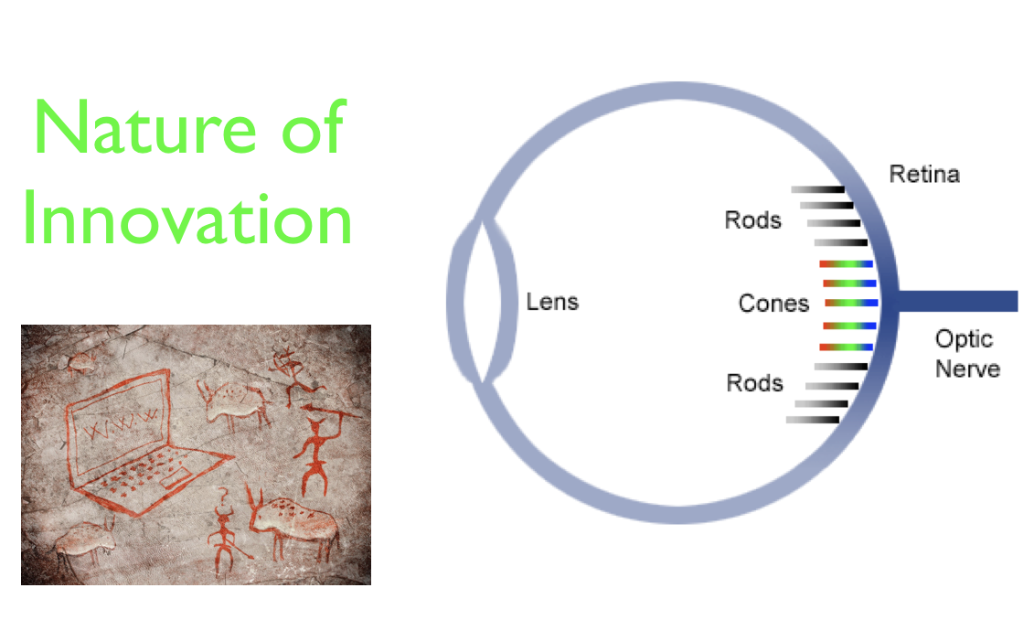
2012 (Prediction)

Slide 17
Millions of learners

Slide 18
Millions of learners and thousands of teachers

Slide 19

What Sal Khan Did Wrong
Accepted the existing K12 curriculum
Ignored standards, interoperability, and reuse
Did not build Open Educational Resources
Single instance software – not open source
Silicon valley / entrepreneur mindset – growth / brand

Slide 20
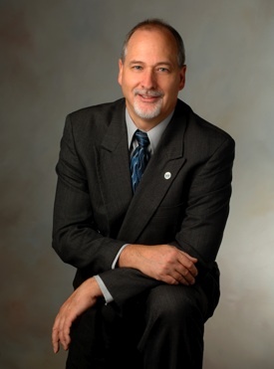
Education for Everybody
Open source software
Open standards / interoperability
Open educational App Store
Open book / materials / assessments
Learning Object Repository
Teach skills not curriculum

Slide 21



Slide 22
LTI Advantage®
CC®
LMS
FOR THE FIRST TIME IN THE HISTORY OF EDUCATIONAL TECHNOLOGY, YOU CAN MAKE AN APP STORE AND LEARNING OBJECT REPOSITORY WITHOUT PROPRIETATY EXTENSIONS.
CC®, and LTI Advantage® are trademarks of IMS Global Learning Consortium, Inc. (www.imsglobal.org)

Slide 23
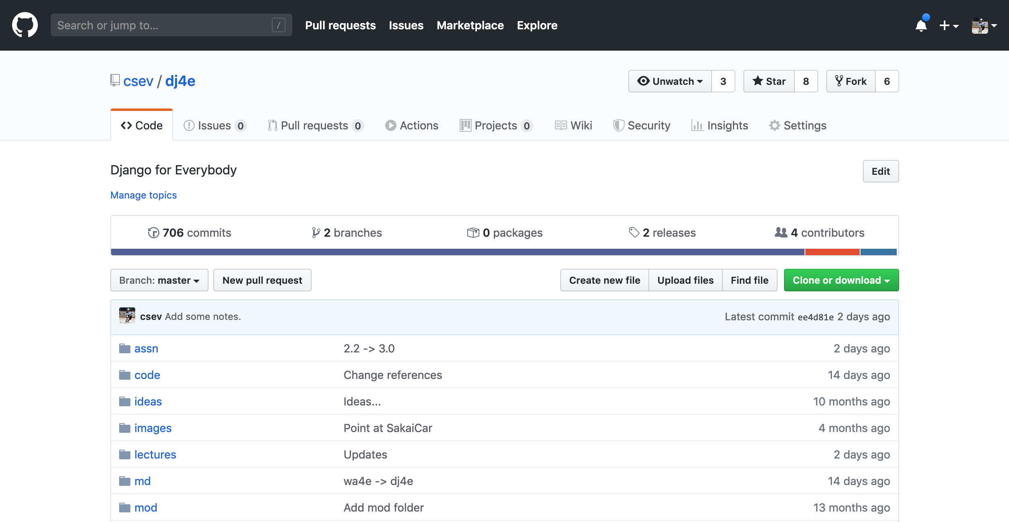

Slide 24
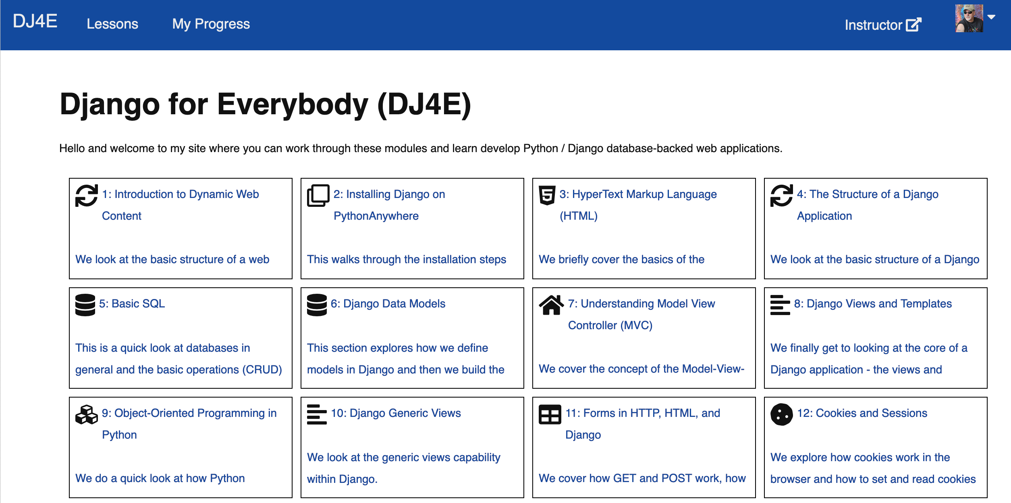

Slide 25

LTI Apps
LOR/MOOC dj4e.com
Autograders (次)
Modules
OER Content (코스)
Pages
Files
Graders
IMS
Canvas
edX
Coursera
Media
FutureLearn
archive.org
YouTube
Amazon
ITunes
Google Play

Slide 26
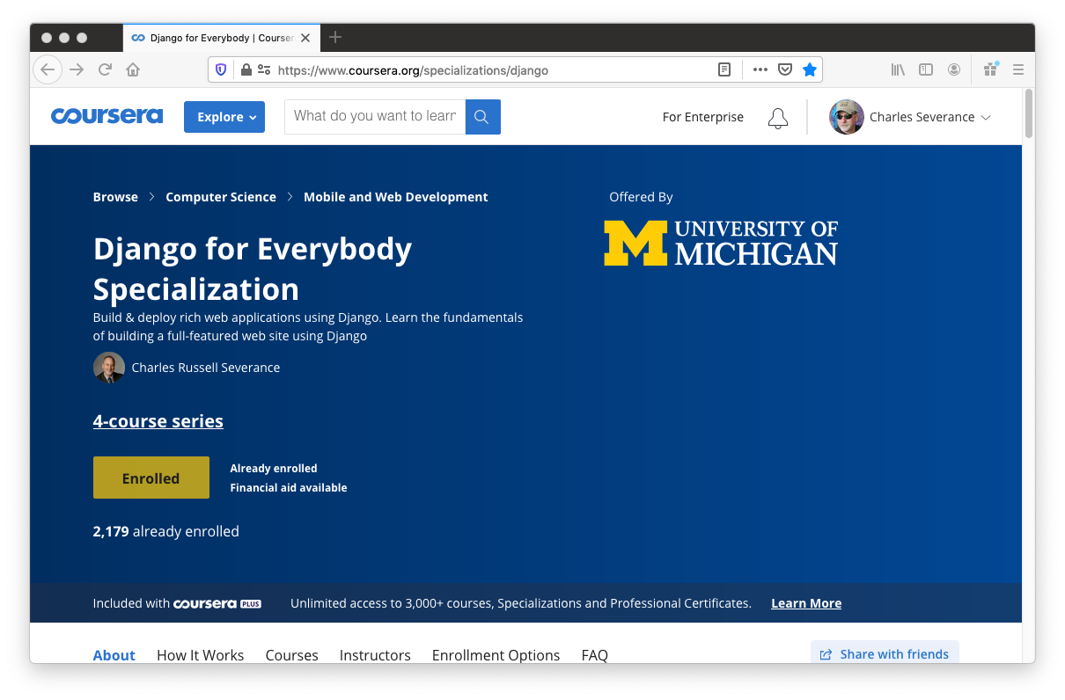

Slide 27
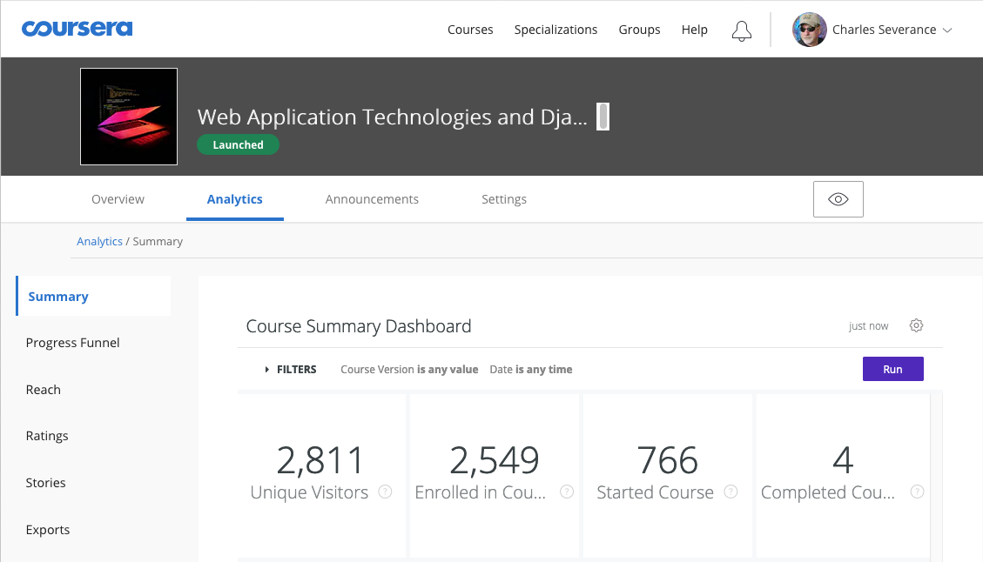
21K
completions
last
week

Slide 28



